Slide 1


COMPUTATIONAL BIOLOGIST AND FULL-STACK BIOINFORMATICS DATA SCIENCE ENGINEERING BOOTCAMP
(Week 4, Session 2)
Notes:
© Copyright Showeet.com – Free PowerPoint Templates

Slide 2
Understanding Merging Heterogeneous Data
INSTRUCTOR: Uche Stephen

Slide 3
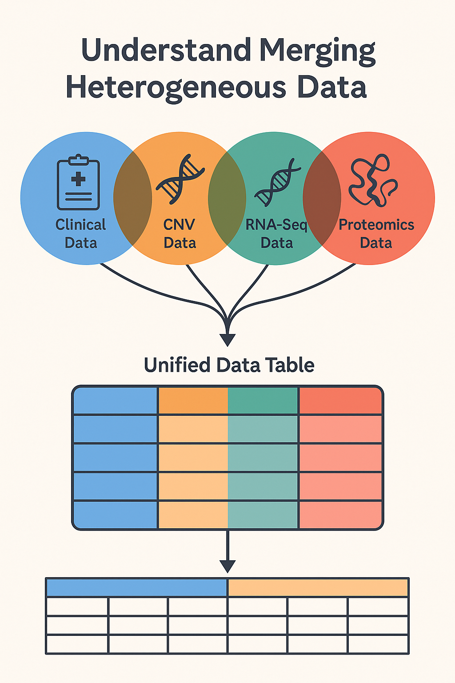

Introduction
Biological systems are inherently complex and multi-dimensional, requiring data-driven insights from multiple perspectives.
Integrative approaches in systems biology unlock hidden biological insights, enabling functional annotation, pathway reconstruction, and precision medicine.
When integrating heterogeneous biological data (like clinical data, CNVs, RNA-Seq, and proteomics), researchers face two major types of challenges:
1. Semantic Challenges - These involve issues related to the interpretation, labeling, and compatibility of data across sources.
2. Technical Challenges - These relate to how the data is formatted, structured, and stored, and how easily it can be combined computationally

Slide 4
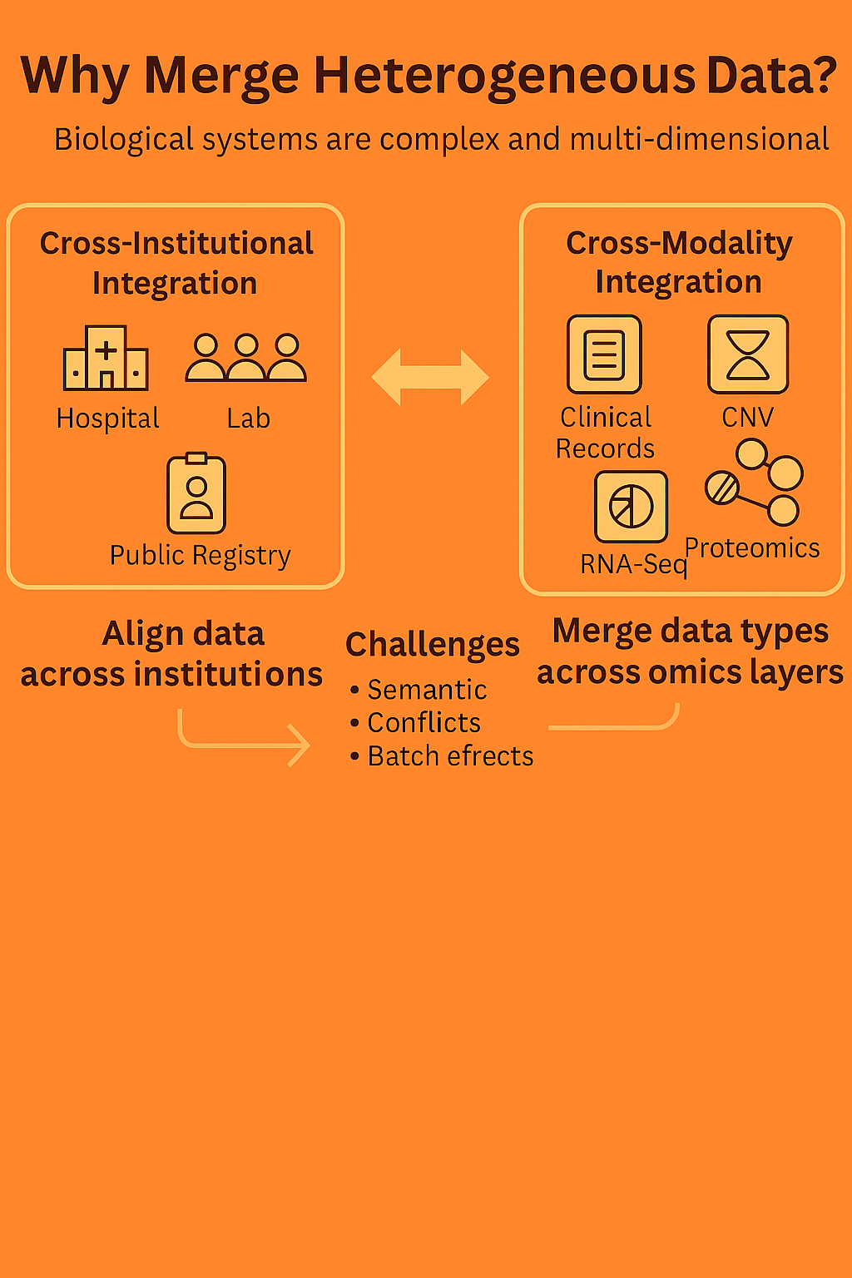
In computational biology and clinical informatics, integrating data is not just about merging spreadsheets. It requires addressing two fundamentally different—but equally important—dimensions of complexity:
cross-institution & cross-modality
Together, cross-institutional (Combining similar types of data across different locations and organizations) and cross-modality (Combining different types of biological and clinical data for the same patient or sample) integration make it possible to:
Build more accurate disease prediction models.
Conduct multi-center studies with harmonized data.
Develop personalized medicine tools powered by full biological context
Combining heterogeneous omics data enhances biomarker discovery, diagnosis, and prediction accuracy. Systems-level analysis becomes possible.
N.B: Both Semantic challenges & Technical challenges must also be addressed for reliable multi-omics data integration in computational biology.
Why Merge Heterogeneous Data?

Slide 5

Omics Data Overview & Modalities
Omics modalities represent distinct layers of molecular and cellular information. Each modality captures a different biological perspective, and together they describe the full complexity of life processes, from DNA to phenotype.
Major Omics Modalities:
Genomics (DNA-Level): Measures genetic sequences and structural variants (e.g., SNPs, CNVs). Represents the blueprint of potential biological function. Enables identification of inherited disease risks or cancer mutations.
Epigenomics (Regulatory Layer):Captures modifications like DNA methylation and histone changes. Controls gene accessibility and transcription without altering the DNA sequence. Key to understanding gene silencing, developmental stages, and environmental impacts.
Transcriptomics (RNA-Level): Analyzes RNA molecules transcribed from DNA. Reflects gene activity and cellular response to stimuli or disease. Techniques: RNA-Seq, microarrays.

Slide 6
Omics Data Overview & Modalities
Proteomics (Protein-Level): Quantifies proteins — the functional molecules in cells. Essential for understanding disease mechanisms and identifying drug targets.
Metabolomics (Metabolic Layer): Measures small molecules and metabolites — end products of cellular processes. Directly reflects physiological changes in cells, tissues, or organisms. Important for studying disease biomarkers, nutrition, and drug responses.
Microbiomics (Environmental Influence): Profiles the microbial populations in hosts (e.g., gut, skin). Linked to immunity, digestion, and systemic health conditions.
Phenomics (Observable Traits): Studies observable traits — influenced by genetics and environment. Links omics-level variations to clinical or behavioural outcomes. Supported by sensors, imaging, and digital health platforms.

Slide 7
Multi-Omics Data Modalities & Integration
Multi-omics integration involves combining multiple omics layers (e.g., genomics, transcriptomics, proteomics) from the same biological system to derive a holistic, layered view of biology.
Why Multi-Omics?
Biological systems are not linear — DNA changes do not always translate into RNA or protein-level effects.
Multi-omics captures causal chains from genotype → expression → phenotype.
Integration improves biomarker discovery, disease subtype classification, and predictive modeling.
The Omics Cascade:
Genomics reveals what could happen (DNA code).
Epigenomics determines what is allowed (gene accessibility).
Transcriptomics shows what is happening (gene expression).
Proteomics tells what’s functioning (active protein).
Metabolomics reflects outcomes (cellular state).
Clinical/Phenotypic data anchor all layers to disease manifestations.

Slide 8
Use Case in Cancer – Metastasis Prediction
Metastasis is a complex, multistep biological process involving genetic, epigenetic, and proteomic changes. Multi-omics integration helps identify cross-layer features that predict whether a tumor will spread.
Biological Problem
Not all tumors metastasize — but existing clinical features (like size or stage) are not enough to predict it reliably. Molecular changes often precede visible clinical symptoms.
How Multi-Omics Helps
CNVs: Identify gene amplifications or deletions that are enriched in metastasis.
RNA-Seq: Highlight overexpressed oncogenes or silenced tumor suppressors.
Proteomics: Detect post-transcriptional changes in signaling or invasion pathways.
Clinical Data: Anchor molecular profiles to real patient outcomes.
Project Objective:
Use integrated CNV, RNA-Seq, proteomics, and clinical data to build a predictive algorithm for distinguishing primary tumors from metastatic lesions.

Slide 9
Challenges in Data Merging
Integrating multi-omics data presents several challenges:
Heterogeneous Data Types: Different omics layers (e.g., genomics, transcriptomics, proteomics) produce data with varying scales, distributions, and formats, complicating integration efforts.
Missing Data: Not all samples have complete data across all omics layers, leading to gaps that can bias analyses if not properly addressed .
Batch Effects: Variations introduced by different laboratories, platforms, or time points can obscure true biological signals.
High Dimensionality: The vast number of features compared to samples increases the risk of overfitting and computational burden.
Interpretability: Complex integration models can be challenging to interpret, making it difficult to derive meaningful biological insights.

Slide 10
Integration Strategies & Tools
Strategies for multi-omics data integration include:
Notable tools supporting these strategies
Early Integration (Data-Level): Combines raw or normalized data from different omics layers into a single dataset for analysis.
Intermediate Integration (Feature-Level): Extracts features from each omics layer separately before combining them for joint analysis.
Late Integration (Decision-Level): Analyzes each omics layer independently and integrates the results at the decision-making stage .
MOFA+ (Multi-Omics Factor Analysis): Unsupervised integration tool that identifies shared factors across omics layers.
DIABLO (Data Integration Analysis for Biomarker discovery using Latent components): Supervised integration method focusing on discriminant analysis.
SNF (Similarity Network Fusion): Merges similarity networks from different omics data to capture shared patterns.
iClusterPlus: Integrative clustering tool that models joint associations across multiple data types.

Slide 11
Data Integration Frameworks
Frameworks facilitating multi-omics data integration:
UNMF (Unified Nonnegative Matrix Factorization): Decomposes multi-omics data into interpretable components, handling missing data and repeated measurements effectively.
GLUE (Graph-linked Unified Embedding): Integrates unpaired single-cell multi-omics data by modeling regulatory interactions across layers.
MOHGCN (Multi-Omics Heterogeneous Graph Convolutional Network): Employs graph-based deep learning to integrate multi-omics data, capturing complex relationships.
DeepKEGG: Utilizes deep learning to integrate multi-omics data with biological pathway information for cancer recurrence prediction.

Slide 12
Unified Data Matrix
Creating a unified data matrix involves:
Data Pre-processing: Normalizing and transforming data from different omics layers to ensure compatibility.
Feature Alignment: Matching features across datasets, such as genes or proteins, to create a cohesive matrix.
Handling Missing Values: Employing imputation techniques or models robust to missing data to maintain matrix integrity.
Dimensionality Reduction: Applying methods like PCA or t-SNE to reduce complexity while preserving essential information.
This unified matrix serves as a foundation for downstream analyses, enabling comprehensive insights across biological layers.

Slide 13
Unified Data Matrix Structure
SampleID | CNV_TP53 | RNA_TP53 | Protein_TP53 | Age | Stage
---------|----------|----------|---------------|-----|------
TCGA-01 | -0.62 | 5.20 | 0.89 | 65 | II
TCGA-02 | 0.15 | 6.10 | 0.43 | 71 | IV

Slide 14
Merging Data for ML & DL Applications
Integrating multi-omics data enhances machine learning (ML) and deep learning (DL) applications:
Improved Predictive Models: Combining data layers leads to more accurate models for disease classification and prognosis.
Feature Selection: Identifying the most informative features across omics layers improves model performance and interpretability.
Handling Complex Relationships: DL models, such as auto-encoders and graph neural networks, capture nonlinear interactions between omics layers.
**Challenges: Ensuring model generalizability, avoiding overfitting, and interpreting complex models remain ongoing concerns.

Slide 15
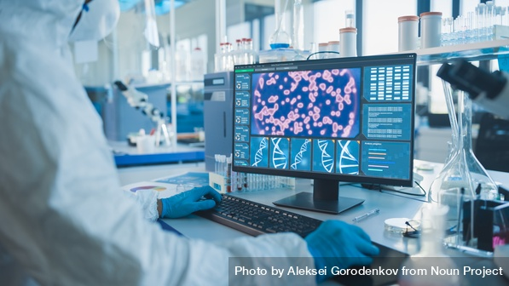
Future Perspectives
Advancements anticipated in multi-omics integration include:
Standardization: Developing universal protocols for data collection, pre-processing, and integration to enhance reproducibility.
Real-Time Data Integration: Incorporating real-time data streams, such as wearable device outputs, for dynamic health monitoring.
Personalized Medicine: Leveraging integrated omics data to tailor treatments to individual patients' molecular profiles.
Scalable Computational Methods: Creating algorithms capable of handling the increasing volume and complexity of omics data.
**Ethical Considerations: Addressing data privacy, consent, and equitable access as multi-omics integration becomes more prevalent in clinical settings.
Notes:
© Copyright Showeet.com – Free PowerPoint Templates

Slide 16
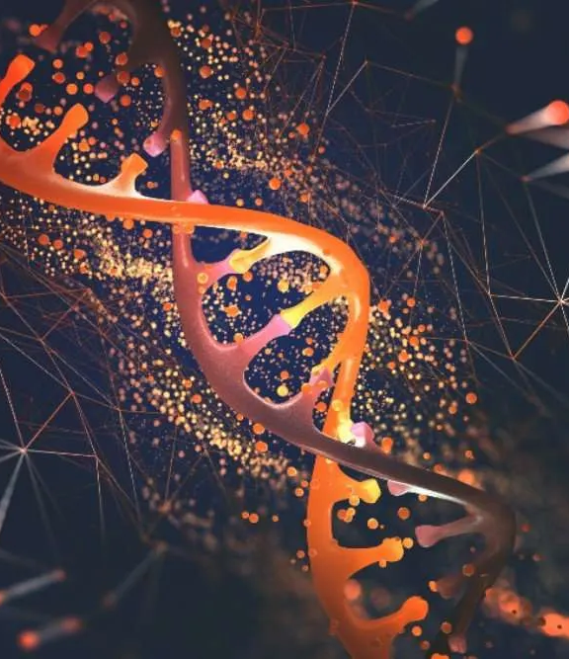

THANK YOU
www.genomachub.com
genomacinnovationhub@gmail.com

